Slide 1
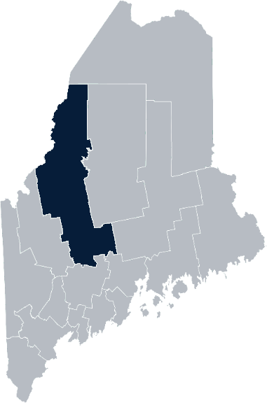
Maine Shared Community Health Needs Assessment Somerset County
2021
Notes:
Terri Vieira, President,
Northern Light Sebasticook Valley Hospital
Richard Willett, CEO,
Redington-Fairview General Hospital

Slide 2
The Maine Shared CHNA is a collaboration between the Maine Center for Disease Control and Prevention (Maine CDC), Central Maine Healthcare, Northern Light Health, MaineGeneral Health, and MaineHealth.
Notes:
Local Planning Committee Member

Slide 3
Forum Agenda
Time | Activity | Speaker/Facilitator
4:00 - 4:10 pm | Welcome and Introductions | Terri Vieira, President, Northern Light Sebasticook Valley Hospital Richard Willett, CEO, Redington-Fairview General Hospital
4:10 - 4:15 pm | Overview of Zoom and CHNA Background | Jo Morrissey, Maine Shared CHNA Program Manager
4:15 - 4:25 pm | Review of previously identified priorities and activities since last effort | Sherry Tardy, Director of Community Health, Northern Light Sebasticook Valley Hospital Matt L’Italien, Project Director, Somerset Public Health
4:25 - 4:45 pm | Presentation of key findings from the data profile | John Snow, Inc.
4:45 - 5:45 pm | Break-out session- facilitated discussion on data and health priority identification | Local Facilitators
5:45 -5:50 pm | Wrap up and next steps | Paula Thomson, Central District Public Health Liaison, Maine CDC
Notes:
Local Facilitator

Slide 4
Share screen
Join Audio, Mute On/Off
Open/close participant list or chat
Turn Video On/Off
Reactions
Notes:
Jo or JSI

Slide 5
Matching Interests
Maine Shared
Community Health Needs Assessment
Images of PHAB and IRS from the internet
Notes:
Jo or JSI

Slide 6
The Evolution of an Idea…
2010 OneMaine | 2015 SHNAPP | 2018 Maine Shared CHNA | 2021 Maine Shared CHNA
Forums Surveys | 16 Forums 1639 Surveys | 22 Mainstream Forums (live) 2 Immigrant Forums 45 Interviews | 16+ Mainstream Forums (virtual) 12+ Community Sponsored Events 2000+ Oral Surveys
Notes:
Jo or JSI

Slide 7
Inputs and Outcomes
Ways to Provide Input
Data Collected
Outcomes
District & County Reports DUE APRIL 2022
4 Health Priorities by county
Related indicators
Gaps/barriers and resources/assets
Notable comparisons between attendee input and the data.
Description of those who provided input
Methodology
Mainstream county forums
Number of attendees
Where attendees live (not CSE)
List of data identified Forums and CSE only)
Discussion notes (Forums and CSE only)
Chat box comments (Forums and CSE only)
Health Priorities
Gaps and Resources
Community sponsored events
State Report DUE APRIL 2022
4 Health Priorities by Community Event and immigrant population.
Related indicators
Gaps/barriers and resources/assets,
Notable comparisons to mainstream population.
Description of those who provided input
Methodology
Oral Survey
Forums, Events and Surveys conducted Fall 2021
Notes:
[Add names of those doing the leadership remarks ie Susan Keiler, VP Strategic Development of Southern Maine Health Care
Dr. Patrick Taylor, CEO/President of York Hospital]
Jo or JSI
Community Sponsored Event Partners include
Disability Rights Maine (2 events: people who are deaf or hard of hearing and people with other disabilities)
Maine Primary Care Association (People who are served by Maine’s Federally Qualified Health Centers
Maine Council on Aging (Older Adults 65+
Consumer Right Council of Maine (people with a mental health diagnosis)
Formerly Incarcerated (Maine Prisoner Re-Entry Network)
Maine Youth Action Network and Friends (Raising the voices of Maine’s diverse youth)
Green Memorial A.M.E. Zion Church (Black/African American)
Health Equity Alliance (LGBTQ+ community)
Portland Recovery Center (for people with a substance use disorder or in recovery)
ADD HOUSING INSECURE IF NEED BE
ADD VETERAN IF NEED BE
Oral Survey Partners include:
City of Portland’s Minority Health Program
New Mainer’s Public Health Initiative
Maine Immigrant Access Network
Gateway Community Services
Maine Immigrant and Refugee Services
Maine Community Integration
Mano en Mano
We are piloting these additional outreach methods with support from
State of Maine’s Preventative Health and Health Services Block Grant
Maine Health Access Foundation
Introduce leader for leadership remarks

Slide 8
Leadership remarks
Notes:
Leadership remarks
Leader to introduce the following who will provide comments on recent health improvement efforts
ADD NAME OF THOSE WHO WILL BE DOING REVIEWING PREVIOUS EFFORTS
Adam Hartwig, District Liaison ME CDC
Sally Manninen, Director, Community Health, York Hospital
Betsy Kelly Director, Community Health Improvement, SMHC

Slide 9
Previous Health Improvement Efforts
Notes:
Local Facilitator

Slide 10
Central District 2019-22 Priority Areas
Hospital and District priority areas of work since the 2018 Shared CHNA
Access to Care | Adverse Childhood Experiences | Chronic Disease | Food Insecurity | Mental Health Services | Obesity, Physical Activity and Nutrition
MaineGeneral Health Redington-Fairview General Hospital | Central District Coordinating Council | MaineGeneral Health Redington-Fairview General Hospital | MaineGeneral Health Northern Light Sebasticook Valley Hospital Redington-Fairview General Hospital | Northern Light Inland Hospital Northern Light Sebasticook Valley Hospital | Central District Coordinating Council MaineGeneral Health Northern Light Inland Hospital Redington-Fairview General Hospital
Oral Health | Poverty | Senior Health | Substance Use Disorder | Tobacco
Central District Coordinating Council MaineGeneral Health | Northern Light Inland Hospital | Redington-Fairview General Hospital | Central District Coordinating Council Northern Light Inland Hospital Northern Light Sebasticook Valley Hospital MaineGeneral Health Redington-Fairview General Hospital | Central District Coordinating Council MaineGeneral Health Northern Light Sebasticook Valley Hospital Redington-Fairview General Hospital
Notes:
Local Facilitator

Slide 11
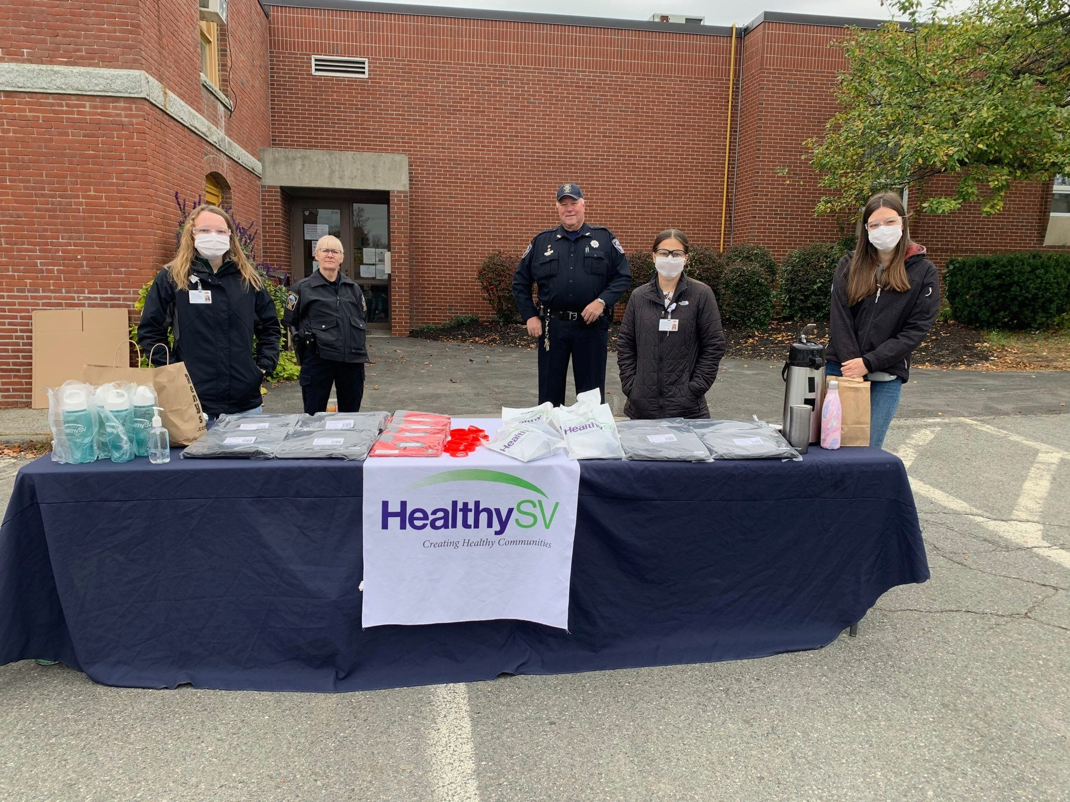
Successes and Outcomes
Northern Light Inland Hospital
MaineGeneral Health
Northern Light Sebasticook Valley Hospital
Redington-Fairview General Hospital
Notes:
Local Facilitator

Slide 12
Pandemic Acknowledgement and Thanks
During this past CHNA cycle – COVID-19 became a public health focus for everyone.
The Central District has experienced a high number of Covid-19 cases and Covid-19 deaths – but has also experienced high levels of collaboration with healthcare partners, emergency management, government, and community members in order to provide testing, vaccination, and other important supports to respond to the pandemic.
This was and continues to be a focus of much of our community work and every day activities.

Slide 13
Thank you to Local Planning Committee!
Sara Barry, Northern Light Sebasticook Valley Hospital
Anne Conners, MaineGeneral Health
Melissa Emmons, MaineGeneral Health
Matt L’Italien, Somerset Public Health
Joy McKenna, MaineGeneral Marketing & Philanthropy
Jessica Ouellette, Northern Light Sebasticook Valley Hospital
Bethany Shalit, Redington-Fairview General Hospital
Sherry Tardy, Northern Light Sebasticook Valley Hospital
Paula Thomson, Maine CDC
Brittney Watt, Redington-Fairview General Hospital

Slide 14
How to Read the County Health Profiles and Health Equity Data Sheets
Notes:
JSI or other facilitator

Slide 15
How to Read County Health Profile
CHANGE shows statistically significant changes in the indicator over time, based on 95% confidence interval (see description on page 3).
ê | means the health issue or problem is getting better over time.
! | means the health issue or problem is getting worse over time.
○ | means the change was not statistically significant.
N/A | means there is not enough data to make a comparison.
BENCHMARK compares [COUNTY] data to state and national data, based on 95% confidence interval (see description on page 3).
ê | means [COUNTY] is doing significantly better than the state or national average.
! | means [COUNTY is doing significantly worse than the state or national average.
○ | means there is no statistically significant difference between the data points.
N/A | means there is not enough data to make a comparison.
ADDITIONAL SYMBOLS
* | means results may be statistically unreliable due to small numbers, use caution when interpreting.
— | means data is unavailable because of lack of data or suppressed data due to a small number of respondents.
EXAMPLE
Notes:
JSI or other facilitator
A star means that the health issue or problem is getting better over time or better in comparison to another place
A red exclamation point means that the health issue or problem is getting worse over time or worse in comparison to another place
A gray circle means that the dating hasn’t changed over time or isn’t much different in comparison to another place
N/A means that there was not enough data to be able to make a comparison
There are two additional symbols you might see:
A black dot means that you should use caution when interpreting the data – the results might be unreliable because of small numbers
A black dash means that data was unavailable, or that data was suppressed due to a small number of respondents
(Go to next slide and walk audience through an example)

Slide 16
How to Read County Health Profile
EXAMPLE
 | AROOSTOOK COUNTY |  |  | BENCHMARKS
INDICATOR | POINT 1 | POINT 2 | CHANGE | MAINE | +/- | U.S. | +/-
Individuals living in poverty | 2009-2011 15.6% | 2015-2019 16.1% | ¡ | 2015-2019 11.8% | ! | 2019 12.3% | N/A
Notes:
Here’s an example of how we’ve visualized the data in the County Health Profiles.
The charts in this presentation are all excerpts from the Data Health Profiles that were created by MaineHealth and the Maine CDC. They contain data pulled from publicly available sources that are designed to help people learn more about the health of their communities. Not all the data points are available for every measure, but we’ve included data wherever we can.
The green bars represent data from your community. The left most one represents a past data point, and the right bar represents the most recent data point available when the data was gathered. These are the same data points used in the Data Health Profiles.
The grey bars represent data for the state of Maine as a whole- on the left- and for the United States as a whole- on the right, when it is available.
We’ve also noted where differences in the data points are ‘statistically significant’. A difference between two measurements is significant when scientists can say, with a known degree of confidence, that the difference between them is large enough that the difference is most likely to be caused by an actual difference in the item being measured, and not caused by error associated taking the measurement. All of these tests are comparing the most recent data point for your community to other data points. A red exclamation mark indicates a difference that your community is significantly different in a less desirable direction compared to the data point with the symbol. A green star indicates that your community is significantly different in a more desirable direction. A grey circle indicates that there is no significant difference.
(keep in presentation – do not read for deaf/HOH event or people with disabilities). A difference between two measurements is significant when scientists can say, with a known degree of confidence, that the difference between them is large enough that the difference is most likely to be caused by an actual difference in the item being measured, and not caused by an error associated taking the measurement. All of these tests are comparing the most recent data point for your community to other data points.
For example, in this slide, we have two symbols. The grey circle next to the measurement for 2009-2011 Aroostook County means that there is no significantly different change in the rate of poverty in Aroostook County when comparing the data from 2009-2011 to the data from 2015-2019. The red exclamation mark next to the Maine data point says there is a significant difference between 2015-2019 Aroostook County and 2015-2019 Maine, and that it is less desirable that Aroostook County has a higher rate of individuals living in poverty. No comparison could be made to the data for the U.S. because the years of data collection were different.

Slide 17
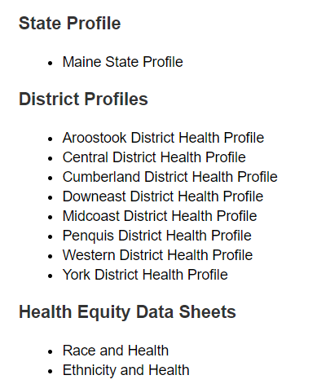
For More Data
www.mainechna.org
Notes:
The Maine Shared CHNA website contains health profiles for 3 of Maine’s largest cities, 16 counties, 5 public health districts, the state, as well as data provided by race, ethnicity, educational attainment, gender, sexual orientation, older adults, insurance status, income, and rurality.
IN addition, there is an interactive data portal where you can search by specific data points. All these breakdowns are then provided by data point.
REGARDING COVID-19 DATA
The Maine Shared CHNA data set does not include any data of COVID-19. This is largely due to the fact that there is a much more up-to-date and comprehensive Maine Data Dashboard continually being updated on the Maine CDC website.
Here you can find daily lab results, new case counts by date, trends, county breakdowns, data by race, and comparisons to other states and the nation.

Slide 18
Key Findings
Notes:
As we walk through the following data slides together, take notes. What surprises you? What stands out? What’s moving in the wrong direction?
Once the data presentation is over, you will be divided into breakout groups to discuss the data, share your top concerns, identify your top priorities, and share your knowledge about what’s working and what we need to work on to addres those top concerns.
Ready? Here we go.

Slide 19
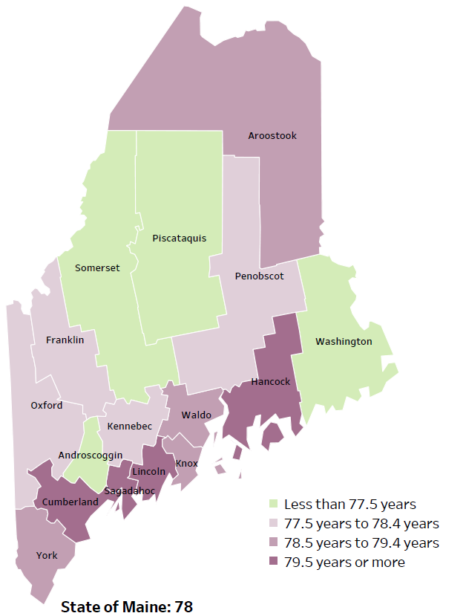
Demographics
Life Expectancy
2017-2019
National Center for Health Statistics,
CDC
RANK | MAINE | SOMERSET
1 | Cancer | Cancer
2 | Heart Disease | Heart Disease
3 | Unintentional Injury | Chronic Lower Respiratory Disease
4 | Chronic Lower Respiratory Disease | Unintentional Injury
5 | Stroke | Stroke
Notes:
The life expectancy in Somerset County is 76.5, which is significantly lower than the state average of 78. Somerset County has the lowest life expectancy in the state. This is an indication that more people are dying at younger ages than residents in many other counties in Maine.
The table on the right side of the slides shows the five leading causes of death in Somerset County. They are also the leading causes of death for the whole state of Maine.
The top two leading causes of death are Cancer and Heart Disease, which are the same as the state’s leading causes of death.
Some highlights:
In Somerset County and Maine overall, the leading cause of death is cancer followed by Heart Disease, and Chronic Lower Respiratory Disease. The opposite is true in the U.S. overall- Heart Disease is the leading cause of death, and cancer as the 2nd leading cause. The 3rd leading cause of death for the County is Chronic Lower Respiratory Disease, which is the 4th leading cause for the State.
The 4th leading cause of death- Unintentional Injury- includes a number of accidental causes: Three of the most common causes are i) Deaths due to motor vehicle crashes, ii) deaths due to accidental falls, iii) deaths due to poisonings that either were unintentional, or the intent was undetermined. Some firearm deaths may also be classified as unintentional. Suicides, some Firearm deaths and some Poisoning deaths are classified as intentional injury
Stroke is the ranked 5th for both the State and Somerset County.
Source: National Center for Health Statistics, US CDC

Slide 20
Demographics
Age distribution for Somerset County
AGE
SOMERSET COUNTY
POPULATION
50,520
STATE OF MAINE
POPULATION
1,362,359
Notes:
Somerset has the 9th largest population of any Maine County after Cumberland, York, Penobscot, Kennebec, Androscoggin, Aroostook, Oxford, and Hancock. The population is aging. There are fewer children and young adults and more adults over the age of 65, and fewer adults of the age where they might expect to have children.
Source: US Census Bureau, American Community Survey

Slide 21
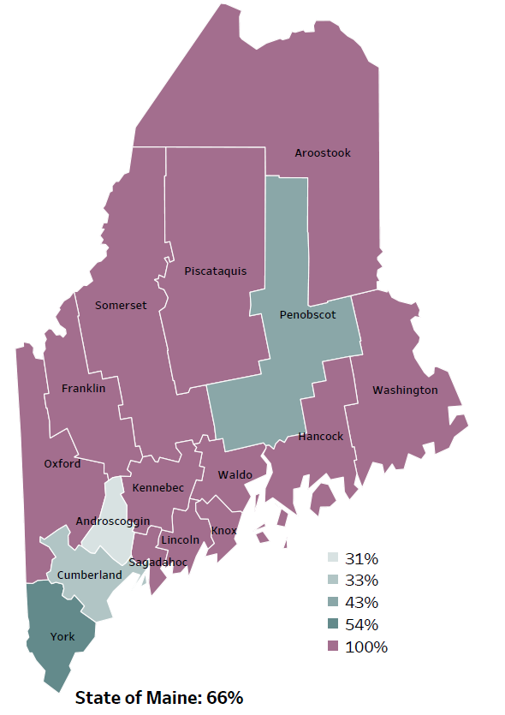
Demographics
Percentage of people living in
rural areas
2019
New England Round Table for Rural Health
Notes:
Somerset County is one of 12 counties with no population in a metro area. These data are based on the most recent Census estimates at the Zip-code level, and calculated use rural Urban Commuting Area codes. The categories were established by the New England Rural Health Association. This data is NOT comparable to 2010 US Census data on populations living in rural areas, as that data uses a different definition for rural.
Source: Data, Research and Vital Statistics town-level population file

Slide 22
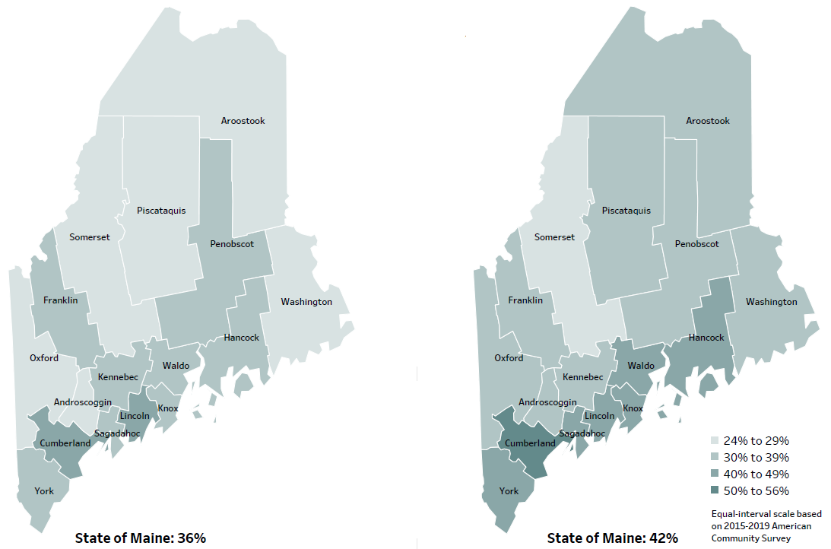
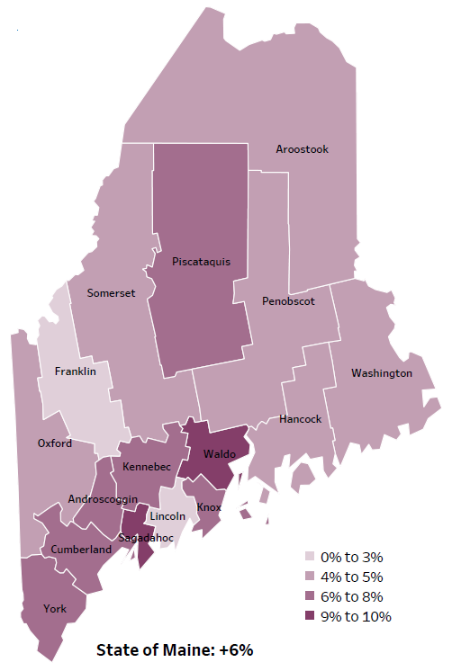
Demographics
Percent of population over age 25 with an associate’s degree or higher
2010
American Community
Survey
Change in percent of population over age 25 with an associate’s degree or higher
2010 to 2015-2019
2015-2019
American Community
Survey
Notes:
These maps show the educational attainment of adults over 25 for two different time periods. Somerset County has had an increase in the rate of adults who have achieved an associate’s degree or higher degree of education. This is highlighted in the change over time map, which shows that this was a greater increase than 2 other counties and equal to 6 other counties.
Source: US Census Bureau, American Community Survey

Slide 23
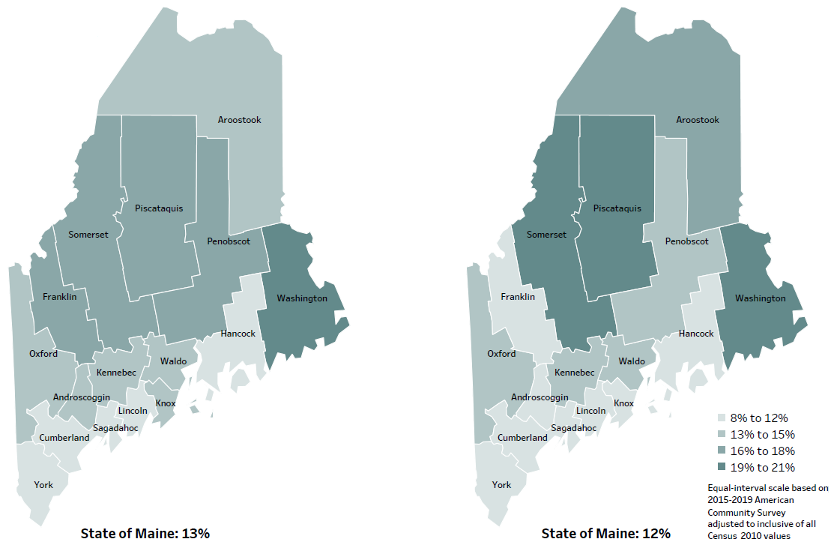
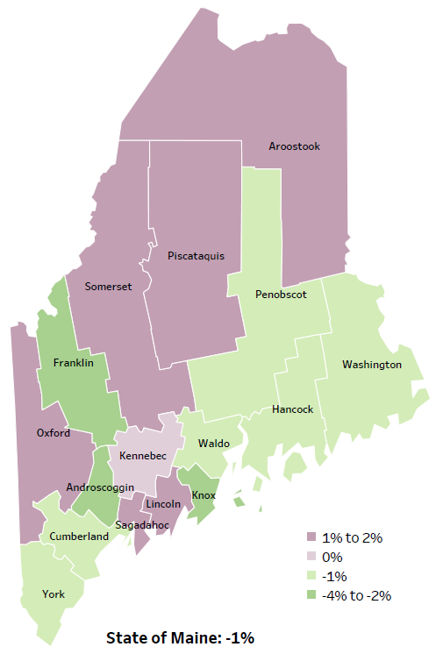
Demographics
Percent of population in poverty
2010
American Community
Survey
Change in percent of population in poverty
2010 to 2015-2019
2015-2019
American Community
Survey
Notes:
These maps show the rate of poverty for two different time periods. Somerset County’s poverty rate has increased over the time period, as shown in the change over time map, and has among the highest levels of poverty in the state. During this period, poverty decreased in Maine overall.
Source: US Census Bureau, American Community Survey

Slide 24
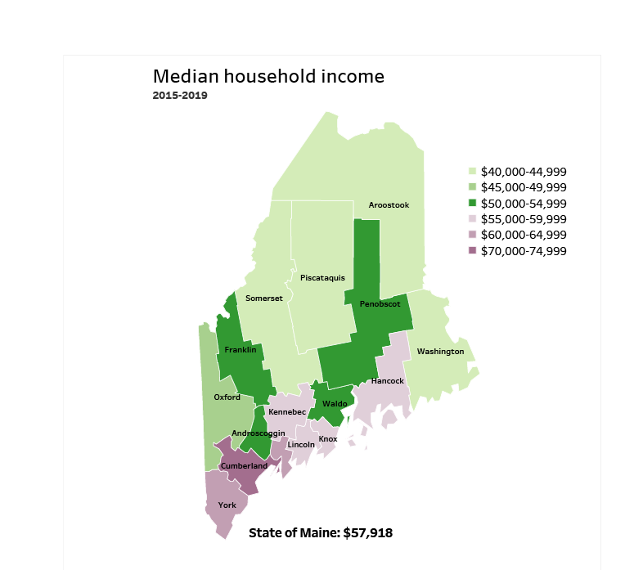
Demographics
Notes:
Somerset County has a median household income of $44,256. Somerset has one of the lowest median incomes in Maine. The income range of $40-$45,000 is equal to 3 other counties. This may be due to a lack of accessible jobs, the rural nature of the area, and relatively low educational attainment for the county.
Source: American Community Survey
Read as needed- Definition: Dollar amount that divides all households in the specified geographic area into two equal groups: half of the households having more income and the other half having less income.

Slide 25
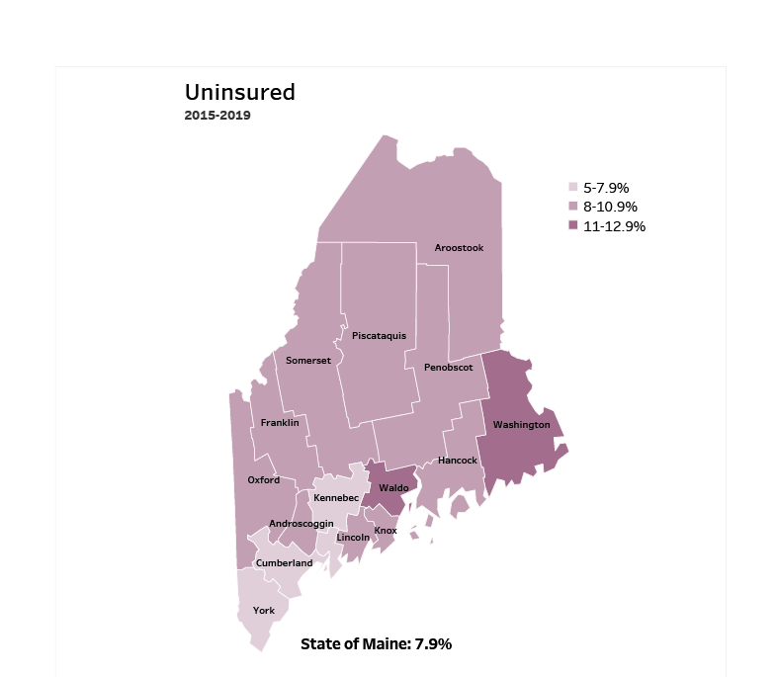
Demographics
Notes:
Somerset has an uninsured rate of 8%, which is higher than 3 counties and equal to 10 counties. Lack of insurance can lead to delayed medical care, emergency room treatment and poorer health outcomes.
Source: American Community Survey
Read as needed- Definition: Percentage of people who do not currently have any form of health insurance (either individually purchased, provided through their employer, or provided through the government).

Slide 26
Health Indicators
Notes:
This graph shows the percent of children (under 18) living in poverty in Somerset County. The percentage of children living in poverty has slightly increased between 2018 & 2019. Somerset remains significantly higher than Maine and the U.S.
Source: US Census Bureau, Small Area Income and Poverty Estimates
Read as needed- Definition: Percentage of children, ages 0-17 years, who live in households where the total income of the householder's family is below the established federal poverty level.

Slide 27
Health Indicators
Notes:
Adverse Childhood Experiences, commonly referred to as ACES, have a significant impact on development and later achievement. This chart shows the percentage of Somerset high school students who reported at least 4 out of 10 adverse events. These events may include abuse, neglect, witnessing domestic violence or parental separation. The questions and criteria to determine ACES changed from 2017 to 2019 and cannot be compared. Past rates were not included for this reason.
Data Source: Maine Integrated Youth Health Survey
Read as needed- Definition: Percentage of high school students who report at least four out of nine adverse childhood experiences. Data collected in odd numbered years.

Slide 28
Health Indicators
Notes:
This graph shows the number of deaths per 100,000 within Somerset County. This rate has increased within the county over time, but the difference is not significant. The rate is significantly higher than the state overall. We have calculated the rates so that they can be compared to other parts of the state that might have a population with a different mix of ages. Older people tend to have higher rates of many diseases and health conditions. It’s important to adjust for age so that we don’t accidentally mistake a place with older people for a place with an unusual number of disease-related deaths.
Source: Maine CDC Vital Records and National Center for Health Statistics, US CDC
Read as needed- Definition: Rate per 100,000 people of deaths from any cause.

Slide 29
Health Indicators
Notes:
These are measures of quality of care, showing the rates of hospitalizations and visits to the ED for conditions that could have been handled in a doctor’s office include PCPs and urgent care. Often this happens because the patient does not have access to a PCP. Somerset County has a significantly higher rate of emergency department visits for ambulatory care-sensitive conditions when compared to the state. These data combine multiple years, in order to make the data more precise. The rate in Somerset County was significantly higher than in the state overall.
Source: Maine Health Data Organization Hospital Inpatient Database
Data Source: Maine Health Data Organization Hospital Inpatient and Outpatient Databases
Read as needed - Definition: Rate per 10,000 people of emergency department discharges with a principal diagnosis of an ambulatory care-sensitive condition. ACSCs are conditions for which good outpatient care can potentially prevent the need for hospitalization, or for which early intervention can prevent complications or more severe disease.
Age-Adjusted Definition: We have calculated the rates so that they can be compared to other parts of the state that might have a population with a different mix of ages. Older people tend to have higher rates of many diseases and health conditions. It’s important to adjust for age so that we don’t accidentally mistake a place with older people for a place with an unusual number of disease-related deaths.

Slide 30
Health Indicators
Notes:
The rate of lung cancer diagnoses amongst Somerset County residents have slightly increased over time. The County’s rate is significantly higher when compared to the state.
Data Source: Maine CDC Vital Records
Read as needed- Definition: Rate per 100,000 people of deaths from lung or bronchus cancers.
Age-Adjustment Definition: We have calculated the rates so that they can be compared to other parts of the state that might have a population with a different mix of ages. Older people tend to have higher rates of many diseases and health conditions. It’s important to adjust for age so that we don’t accidentally mistake a place with older people for a place with an unusual number of disease-related deaths.

Slide 31
Health Indicators
Notes:
Cardiovascular disease deaths have remained relatively stable within the county over time, seeing only a slight increase. The State’s overall rate of deaths due to cardiovascular disease is significantly lower than Somerset County’s.
Data Source: Maine CDC Vital Records Read as needed - Definition: Rate per 100,000 people of deaths with cardiovascular disease as an underlying cause of death.
Age-Adjustment: We have calculated the rates so that they can be compared to other parts of the state that might have a population with a different mix of ages. Older people tend to have higher rates of many diseases and health conditions. It’s important to adjust for age so that we don’t accidentally mistake a place with older people for a place with an unusual number of disease-related deaths.

Slide 32
Health Indicators
Notes:
Chronic lower respiratory deaths within Somerset County have increased since 2007-2011. Somerset County’s rate is higher than both the State and the U.S. The difference is considered significant.
Data Source: Maine CDC Vital Records and CDC WONDER Online Database
Read as needed - Definition: Rate per 100,000 people of deaths due to chronic lower respiratory disease.

Slide 33
Health Indicators
Notes:
Injury-related deaths are the 4th leading cause of death in Somerset County. The rate has risen significantly within the county and is now significantly higher than the State of Maine’s rate of injury related deaths.
Data Source: Maine CDC Vital Records
Read as needed- Definition: Rate per 100,000 people of deaths due to injuries.
Age Adjustment Definition: We have calculated the rates so that they can be compared to other parts of the state that might have a population with a different mix of ages. Older people tend to have higher rates of many diseases and health conditions. It’s important to adjust for age so that we don’t accidentally mistake a place with older people for a place with an unusual number of disease-related deaths.

Slide 34
Health Indicators
Notes:
The rate of fall related deaths within Somerset County have increased significantly since 2007-2011 and is now slightly lower than Maine’s overall rate. This indicator has been age-adjusted, so the increase cannot be attributed to Somerset’s older population. Note the 2007-2011 rate within Somerset County is extremely low and should be interpreted with caution as it’s based on very few cases.
Data Source: Maine CDC Vital Records
Read as needed - Definition: Rate per 100,000 people of deaths due to unintentional falls.
Age Adjustment Definition: We have calculated the rates so that they can be compared to other parts of the state that might have a population with a different mix of ages. Older people tend to have higher rates of many diseases and health conditions. It’s important to adjust for age so that we don’t accidentally mistake a place with older people for a place with an unusual number of disease-related deaths.

Slide 35
Health Indicators
Notes:
This indicator shows unintentional or undetermined poisoning, meaning these deaths are not due to suicide or other intentional injuries. As you can see the rate within Somerset County has increased. This increase is significant and is now slightly below the State’s rate.
Data Source: Maine CDC Vital Records
Read as needed- Definition: Rate per 100,000 people of deaths due to poisonings of unintentional and undetermined intent.
Age Adjustment Definition: We have calculated the rates so that they can be compared to other parts of the state that might have a population with a different mix of ages. Older people tend to have higher rates of many diseases and health conditions. It’s important to adjust for age so that we don’t accidentally mistake a place with older people for a place with an unusual number of disease-related deaths.

Slide 36
Health Indicators
Notes:
This chart shows the rate of firearm deaths, due to either homicide, suicide, or by accident within Somerset County. Somerset’s rate is significantly higher than Maine overall.
Source: Maine CDC Vital Records
Read as needed. Definition: Rate per 100,000 people of deaths due to firearms, all intents.
Age Adjustment Definition: We have calculated the rates so that they can be compared to other parts of the state that might have a population with a different mix of ages. Older people tend to have higher rates of many diseases and health conditions. It’s important to adjust for age so that we don’t accidentally mistake a place with older people for a place with an unusual number of disease-related deaths.

Slide 37
Health Indicators
Notes:
The rate of suicide deaths has increased over time in Somerset County and are slightly higher than Maine as a whole. None of these differences are significant.
Source: Maine CDC Vital Records
Read as needed- Definition: Rate per 100,000 people of deaths due to suicide.
Age-Adjustment Definition: We have calculated the rates so that they can be compared to other parts of the state that might have a population with a different mix of ages. Older people tend to have higher rates of many diseases and health conditions. It’s important to adjust for age so that we don’t accidentally mistake a place with older people for a place with an unusual number of disease-related deaths.

Slide 38
Health Indicators
Notes:
This measure shows the percentage of adults who have lost 6 or more teeth due to tooth decay or gum disease, As you can see, the percentage of adults in Somerset County who have dealt with tooth loss is higher than the State’s rate overall. This difference is significant.
Data Source: Maine Health Data Organization Hospital Inpatient and Outpatient Databases
Read as needed - Definition: Percentage of adults who have lost six or more teeth due to tooth decay or gum disease. Data collected in even numbered years.

Slide 39
Health Indicators
Notes:
An ambulatory care condition is one that could be avoid with good preventative care or early intervention. This slide shows the rate of children within Somerset County who needed ambulatory care due to a dental emergency, which primarily includes untreated cavities. Somerset’s rate is significantly higher than Maine’s overall rate.
Data Source: Maine Health Data Organization Hospital Inpatient and Outpatient Databases
Read as needed - Definition: Rate per 10,000 children with emergency department (ED) visits for dental-related reasons for which good regular dental care can potentially prevent the need for hospitalization, or for which early intervention can prevent complications or more severe disease. Note that included conditions for children are primarily for untreated cavities and are different for adults.

Slide 40
Health Indicators
Notes:
This graph shows rate of deaths for which drugs are the underlying cause, including those attributable to acute poisoning by drugs and those from medical conditions resulting from chronic drug use. Deaths due to alcohol use are not included. The rate of drug-induced deaths among Somerset County residents is significantly higher with in the county, but not when compared to the state.
Source: Maine CDC Vital Records and CDC WONDER Online Database
Read as needed- Definition: Rate per 100,000 people of deaths for which drugs are the underlying cause, including those attributable to acute poisoning by drugs and those from medical conditions resulting from chronic drug use. Deaths due to alcohol use are excluded.
Age-Adjustment Definition: We have calculated the rates so that they can be compared to other parts of the state that might have a population with a different mix of ages. Older people tend to have higher rates of many diseases and health conditions. It’s important to adjust for age so that we don’t accidentally mistake a place with older people for a place with an unusual number of disease-related deaths.

Slide 41
Health Indicators
Notes:
Environmental tobacco smoke exposure among high school students has decreased in Somerset County since 2011. Environmental smoke exposure is defined as being in the same room as someone who was smoking cigarettes at least one day during the past seven days. Somerset County’s rate is significantly higher compared to the U.S.’s rate.
Data Source: Maine Integrated Youth Health Survey
Definition: Percentage of high school students who were in the same room with someone who was smoking cigarettes at least one day during the past seven days. Data collected in odd numbered years.

Slide 42
Health Indicators
Notes:
Environmental tobacco smoke exposure among middle school students has decreased in Somerset County between 2017 & 2019. Somerset County’s rate of 7th and 8th grade students exposed to tobacco smoke is significantly higher than the State’s rate of exposure.
Data Source: Maine Integrated Youth Health Survey
To be read as needed - Definition: Percentage of high school students who were in the same room with someone who was smoking cigarettes at least one day during the past seven days. Data collected in odd numbered years.

Slide 43
Health Indicators
Notes:
Food insecurity rates have increased between 2016 & 2019. Although Somerset’s rate is higher than the State, the difference is not considered significant. Those who experience food insecurity in Maine are roughly equal to the US overall. We cannot compare significance between the state and country since different years are being reported.
Want to note that there are indicators that during the COVID pandemic- 2020 and 2021 that the percent of people/families experiencing food insecurity may have increased.
Data Source: Feeding America: Map the Meal To be read as needed. Definition: Percentage of households that lack access, at times, to enough food for an active, healthy life for all household members, or that have limited or uncertain availability of nutritionally adequate food.

Slide 44
Health Indicators
Notes:
This slide shows the percentage of Somerset County residents under the age of 18 who have experienced food insecurity. Food insecurity is when a household lacks access, at times, to enough food for an active, healthy life for all members or there is limited or uncertain access to food that meets an individual's nutritional needs. As you can see, the percentage of food insecure youth in Somerset County is higher than the state and US rate, but the difference is not significant.
Data Source: Feeding America: Map the Meal To be read as needed. Definition: Percentage of households that lack access, at times, to enough food for an active, healthy life for all household members or that have limited or uncertain availability of nutritionally adequate food. Youth refers to children under 18.

Slide 45
Health Indicators
Notes:
This slide shows the percentage of Somerset County students (enrolled in either elementary, middle, or high school) who are eligible for free or reduced lunch. Children are eligible if their household income is less than 185% of poverty level. The percentage of children eligible for free or reduced lunch in Somerset County is significantly higher than Maine’s rate overall. Currently, lunch is free to all Maine public school students.
Data Source: Maine Dept. of Education
Read as needed- Definition: The percentage of students enrolled in school who are eligible for free of reduced lunch. Students living in families at less than 185% of the poverty level are eligible.

Slide 46
Health Indicators
Notes:
This indicator shows the rate of Somerset County residents who have received the seasonal flu shot. The County’s rate has increased over time, but Somerset’s rate remains slightly lower than the State’s overall rate.
Source: Behavioral Risk Factor Surveillance System
Read as needed- Definition: Percentage of adults who had either a seasonal flu shot or a seasonal flu vaccine that was sprayed in their nose during the past 12 months.

Slide 47
Health Indicators
Notes:
The rate of Somerset County residents being treated in the emergency room for a mental health condition is higher than the State’s rate. This could be related to a lack of access to mental health professionals in the area.
Data Source: Maine Health Data Organization Hospital Inpatient and Outpatient Databases To be read as needed. Definition: Rate per 10,000 people of emergency department discharges with a principal diagnosis of mental health condition.
Age-Adjustment: We have calculated the rates so that they can be compared to other parts of the state that might have a population with a different mix of ages. Older people tend to have higher rates of many diseases and health conditions. It’s important to adjust for age so that we don’t accidentally mistake a place with older people for a place with an unusual number of disease-related deaths.

Slide 48
Health Indicators
Notes:
This slide shows the rate of depression among Somerset County adults. There has been a steady decrease over time. The rate is slightly lower than the overall state rates but this difference is not considered significant.
Data Source: Behavioral Risk Factor Surveillance System
Read as needed- Definition: Percentage of adults who have ever been told by a healthcare provider that they have a depressive disorder.

Slide 49
Health Indicators
Notes:
This slide shows Somerset County high school students who reported of feeling sad and hopeless for two weeks or more during the past 12 months and caused them to stop doing some of their usual activities. Depression in adolescence is linked with increased risks for negative effects on growth and development, school performance, and peer/family relationships in later adolescence. The precent has increased in Somerset County between 2017 and 2019. Somerset County’s rate is higher than the overall State but the difference is not significant.
Data Source: Maine Integrated Youth Health Survey
Adolescent Mental Health Data.pdf (ucsf.edu)
Data Source: Maine Integrated Youth Health Survey To be read as needed. Definition: Percentage of high school students who felt so sad or hopeless almost every day for two weeks or more in a row during the past 12 months that they stopped doing some usual activities. Data collected in odd numbered years.

Slide 50
Breakout Discussions

Slide 51
Wrap up and Next Steps

Slide 52
For more information, please contact:
Paula Thomson, Central District Public Health Liaison, Maine CDC: paula.thomson@maine.gov
Sherry Tardy, Community Health Director, Northern Light Sebasticook Valley Hospital: stardy@northernlight.org
Matt L’Italien, Project Director, Somerset Public Health: mlitalien@rfgh.net
Jo Morrissey, Maine Shared CHNA, info@mainechna.org www.mainechna.org

